Slide 1

Bop it update

Slide 2

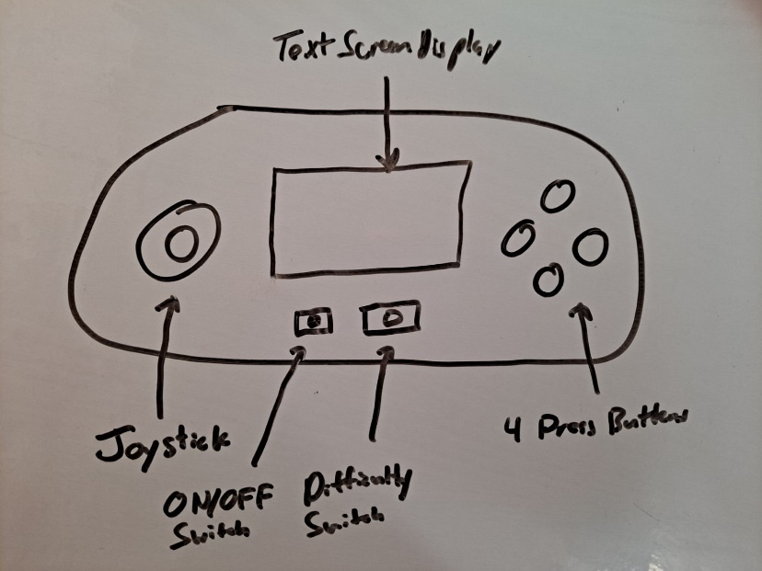
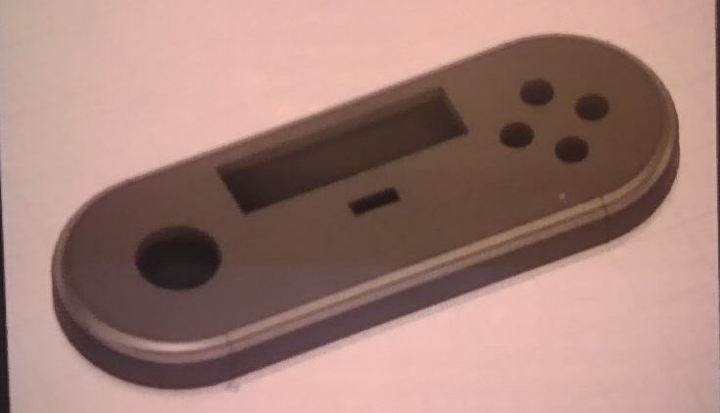
Proposal and Enclosure Design
Initial Proposal
Functionality
Difficulty Switch
Enclosure Design
Changes From Proposal

Slide 3

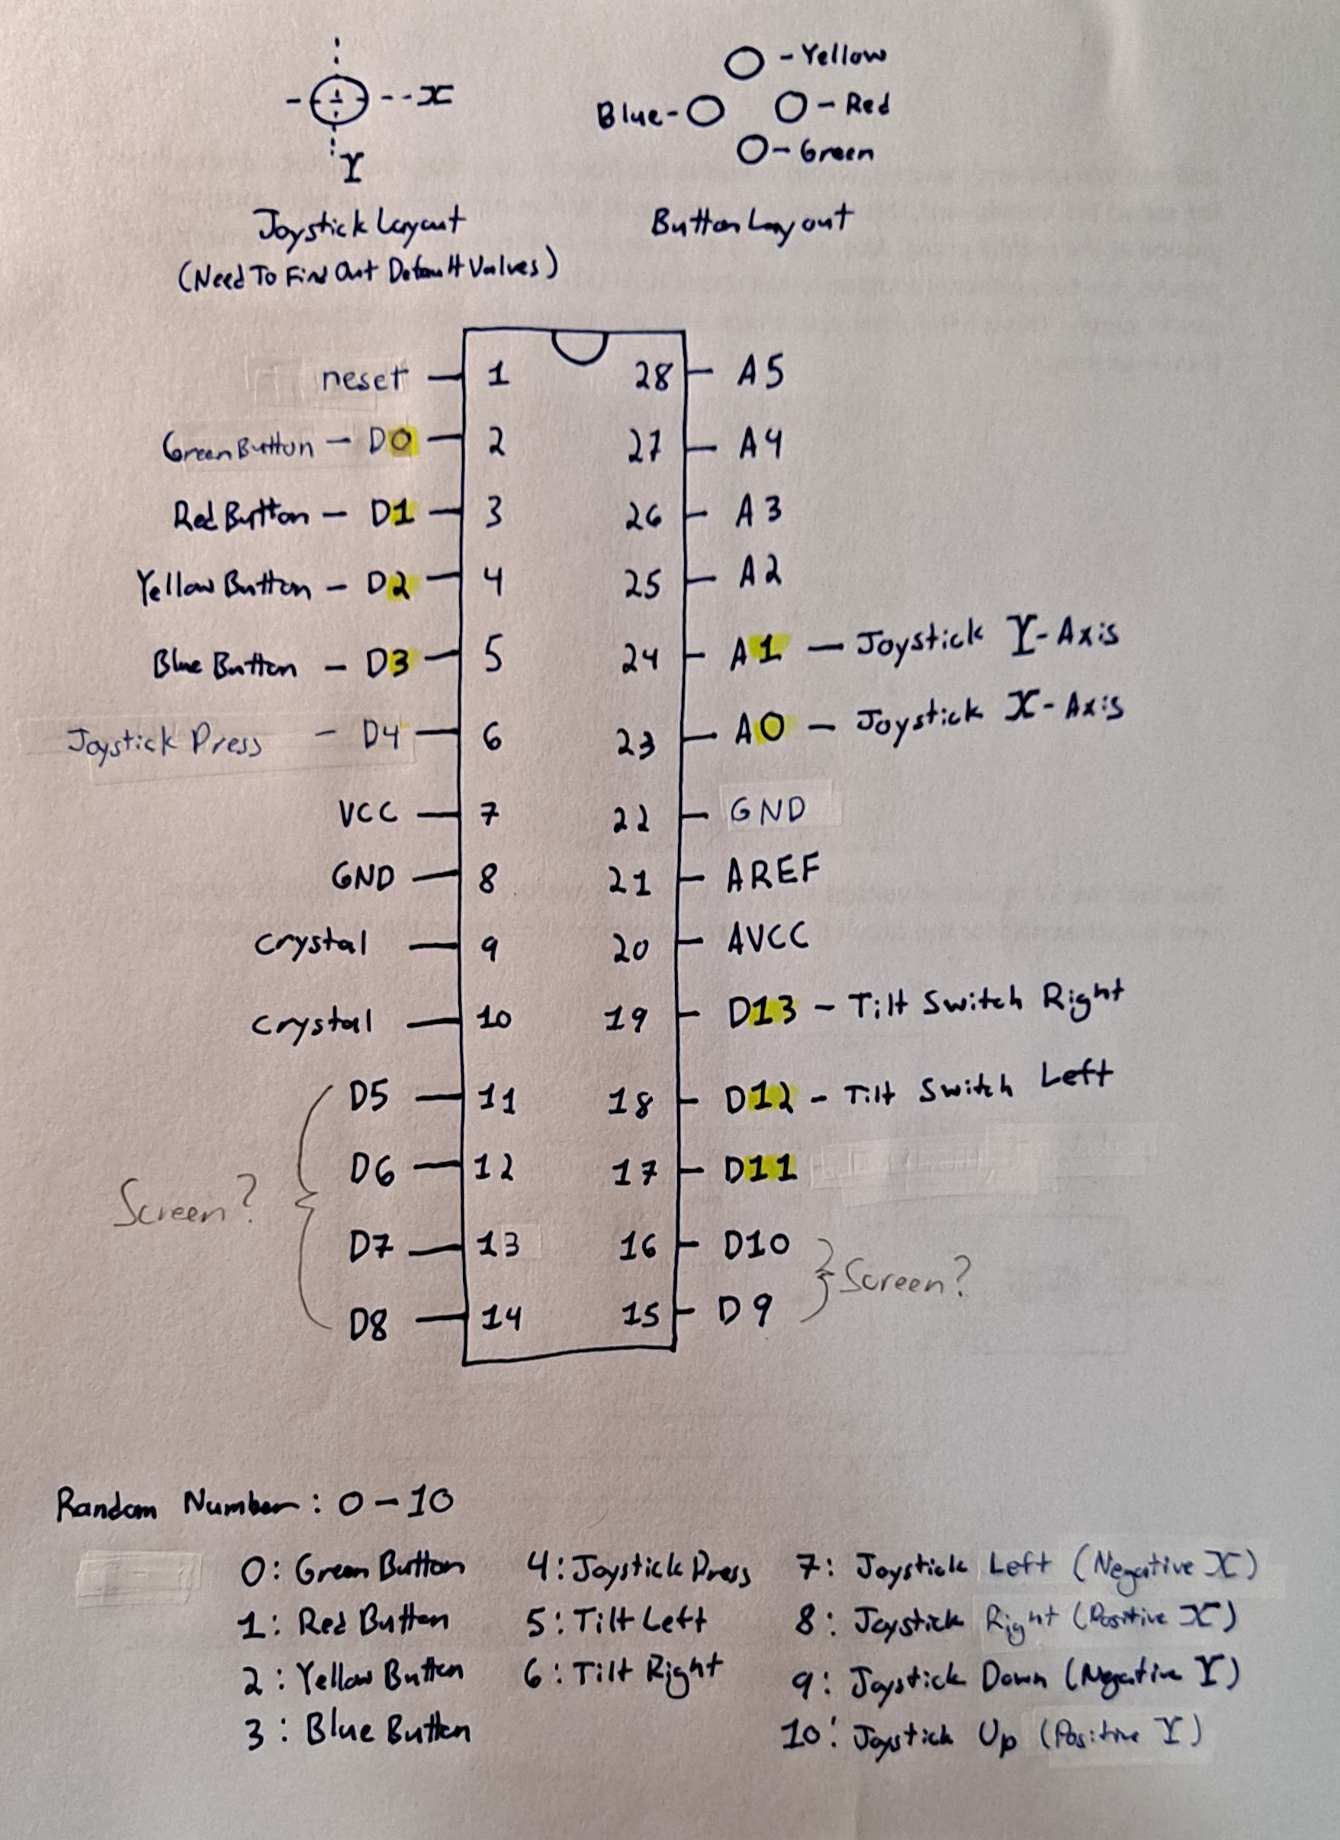
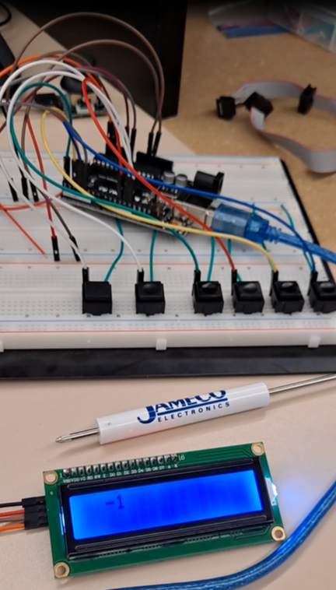
Coding and Testing Process
Code Design
Planning
Read Input Function
Breadboarding Process
Uno Board
Pocket Programmer

Slide 4

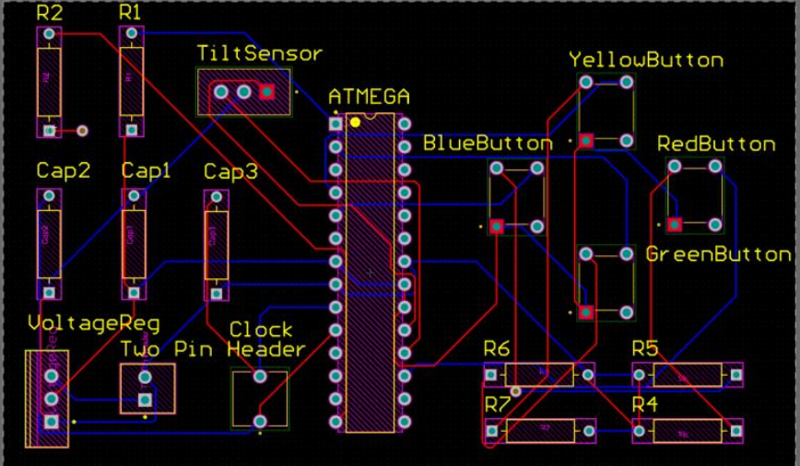
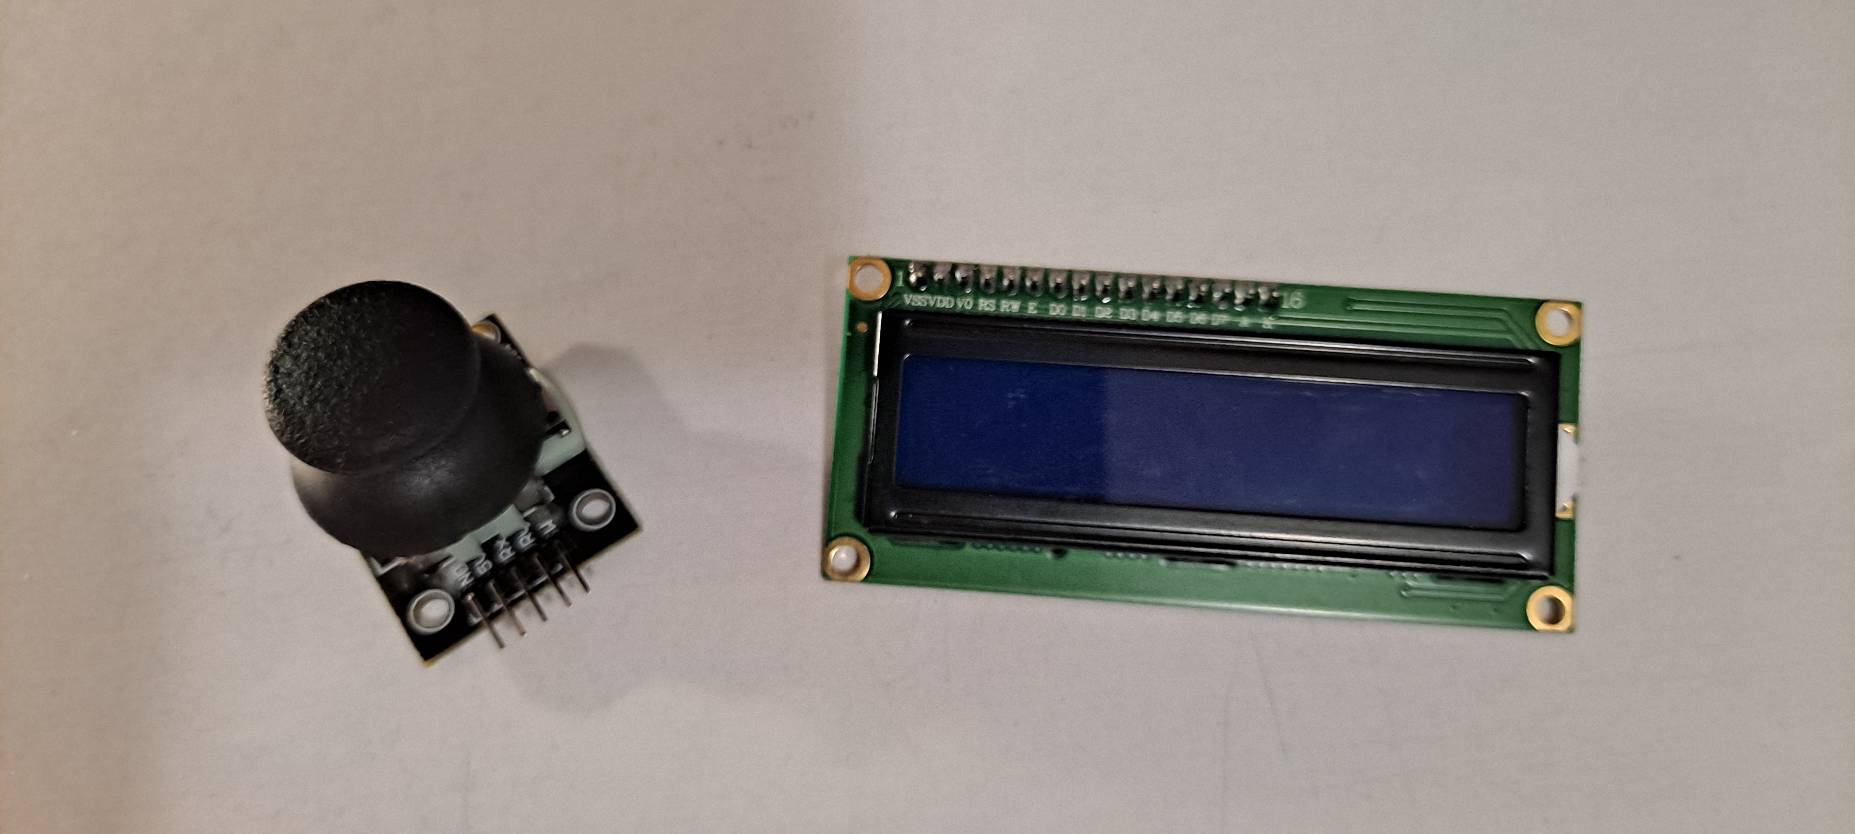
PCB Design
Plan for mounting within Enclosure

